Slide 1
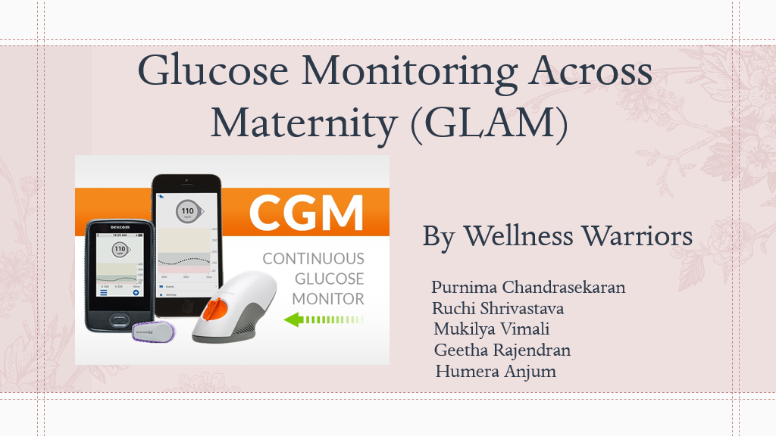

Slide 2
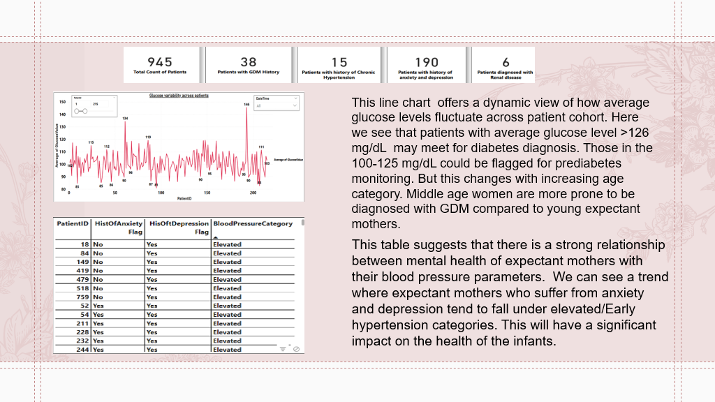
Critical Health Parameters of Expectant Mothers

Slide 3

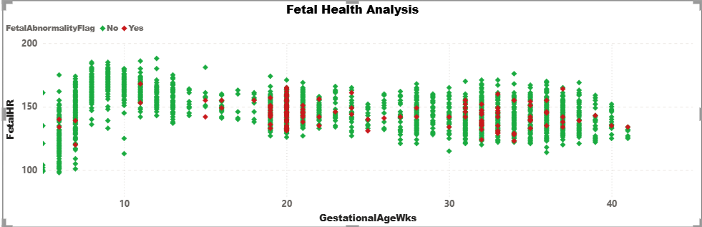
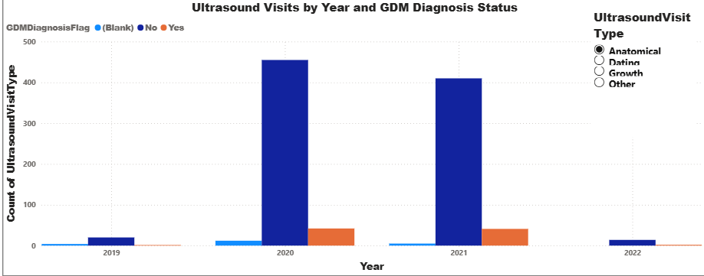
Maternity and Fetal Health Insights
Fetal heart rate generally ranged between 120–160 bpm across gestational ages.
Most data points (in green) indicate normal fetal conditions, while a smaller cluster of abnormalities (in red) appeared throughout different weeks, particularly between 20–35 weeks.
Ultrasound visits peaked in 2020 and 2021, with the majority linked to participants without GDM diagnosis (blue). A smaller but consistent portion of scans involved GDM-positive patients (orange), showing continued monitoring across years. The Anatomical ultrasound type dominated throughout, reflecting its key role in prenatal assessment, while 2019 and 2022 recorded minimal visit counts.

Slide 4
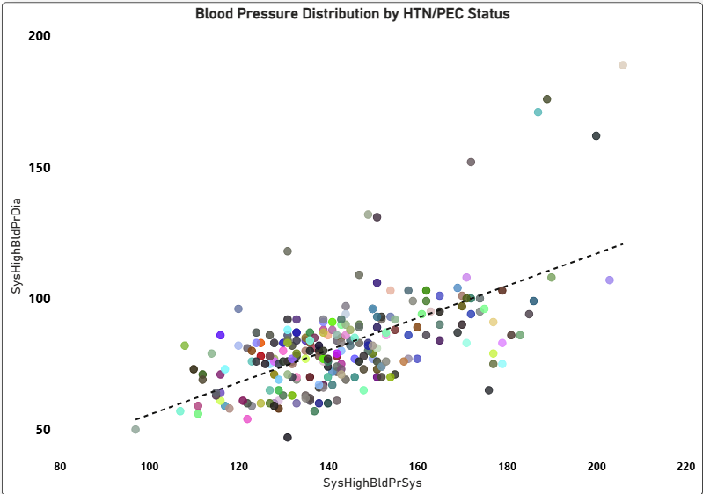
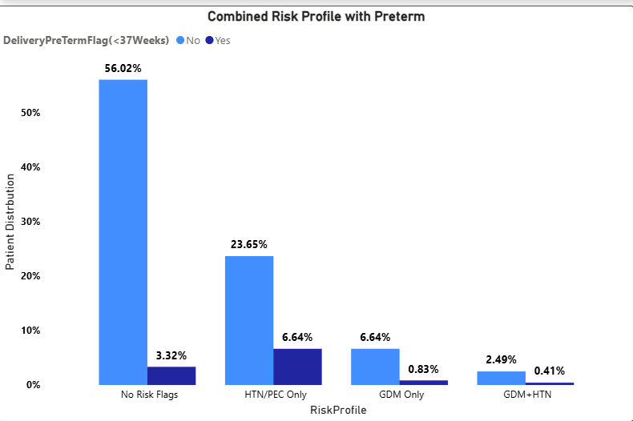
Hypertension and Preterm Risk in C-Section deliveries
4
Maternal Risk Highlights
BP Correlation: Systolic and diastolic pressures show a strong positive correlation, clustering in the hypertensive zone—suggesting maternal cardiovascular strain as a key driver of C-section decisions.
Preterm Risk: HTN/PEC-only patients had a 6.64% preterm delivery rate—nearly 8× higher than GDM-only cases—highlighting hypertension as a stronger predictor of early delivery.

Slide 5
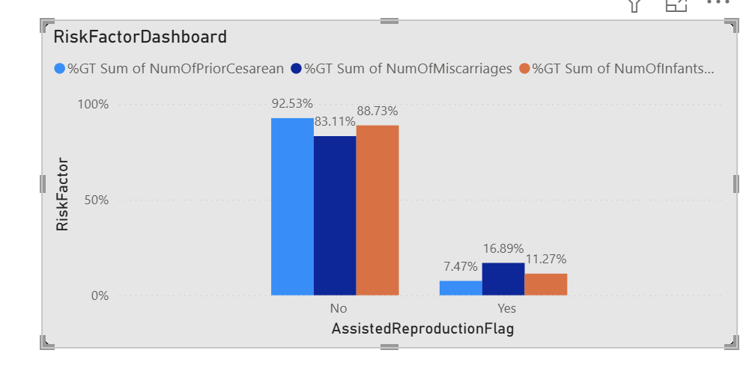
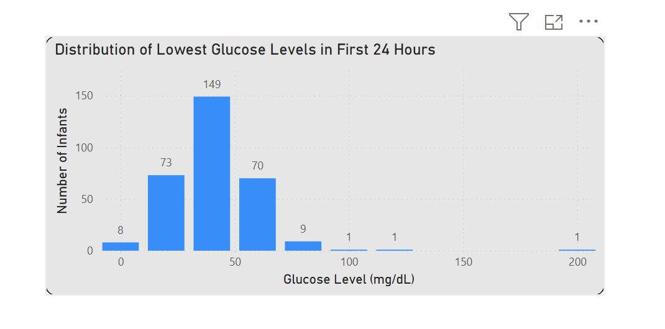
Pregnancy and Infant Insights
Pregnancy Highlights:
Among 717 births, 7.4% were preterm—split evenly between spontaneous and medically indicated. IVF was the dominant assisted method, linked to fewer maternal risks. Traditional conception showed higher cesarean, miscarriage, and NICU rates, suggesting underlying disparities. First-time pregnancies were common, likely age-related.
Infant Health: Gender distribution was balanced, anomalies were rare (3.7%), and birth weights averaged around 3000g. NICU admissions occurred across weight groups, indicating weight alone isn’t predictive. Hypoglycemia was more frequent in females, and glucose levels typically clustered near 50 mg/dL—though 8 infants had critical lows requiring urgent care. Most received oral treatment (68%), with low rates of phototherapy (8%) and birth injuries (0.84%).

Slide 6
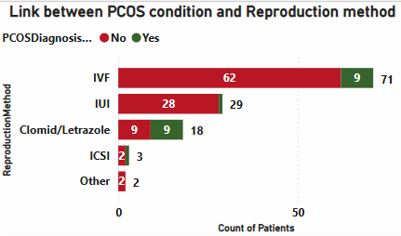
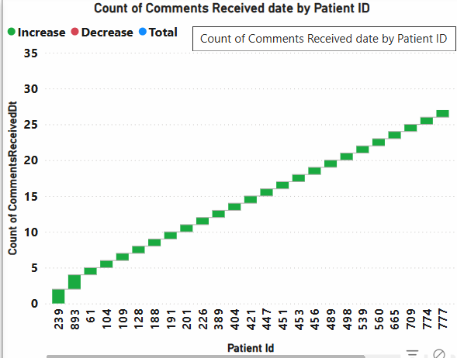
PCOS and General Comments
In this bar chart, among specified methods, IVF has the highest patient count. Clomid/Letrazole and IUI also show notable PCOS representation. These are often first-line treatments for PCOS-related infertility, suggesting a stepwise treatment pattern: Clomid/Letrazole → IUI → IVF/ICSI if needed. ICSI and Other Methods Are Less Common.
This Waterfall Chart reveals a focused story about patient-level engagement or documentation activity.A few PtIDs (e.g., 829, 873, 61) have remarkably high counts of comments, reaching up to 30–35 entries. Most PtIDs have moderate to low comment counts, while a handful dominate the chart

Slide 7

THANK YOU

